Slide 1
Simulation and optimization of the coupling efficiency from single-mode fibers to photonic waveguides
Buyu Xiao
Examinors: Prof.Dr.-Ing. Rolf Schuhlmann

Slide 2
Overview
Motivation and Objective
Project Introduction
Modelling
Optimization
Conclusion and Outlook

Slide 3
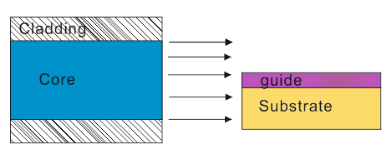

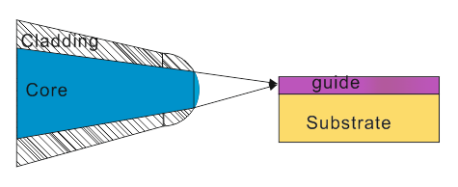
Motivation and Objective
Fiber-to-Chip
Motivation:
Fiber-to-Chip?
Coupling problems.
Tapered lensed Fiber.
Objective:
Analyzing different techniques to affect coupling efficiency.
Improving coupling efficiency.
Notes:
In integrated optic it is often to project light from optical fibers to photonic waveguides (so called Fiber-to-Chip).
As the signal source optical fibers have usually a larger end face than that of waveguides and the direct coupling from fibers to waveguides cause a very low coupling efficiency.
So tapered and lensed fibers (TLF) are applied to replace regualar fibers. Through TLF light power is confined in small range adapting to waveguide dimensions.
But it is not the only solution for promoting the coupling efficiency. There are more actions can be done for optimizing the coupling.
This work aim to analyze different techniques to affect the coupling from TLF to waveguide, and find out the optimal configurations. The caurse of light propagation can be divided in 3 tracks.The TLF handle the propagation at track 1. Following we talking about the optimal actions at track 2 and 3.

Slide 4
Overview
Motivation and Objective
Project Introduction
Modelling
Optimization
Conclusion and Outlook

Slide 5
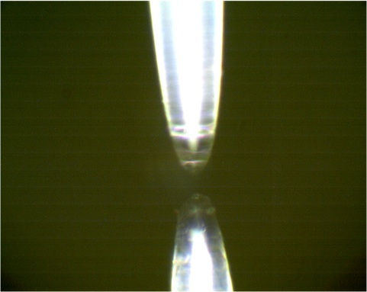
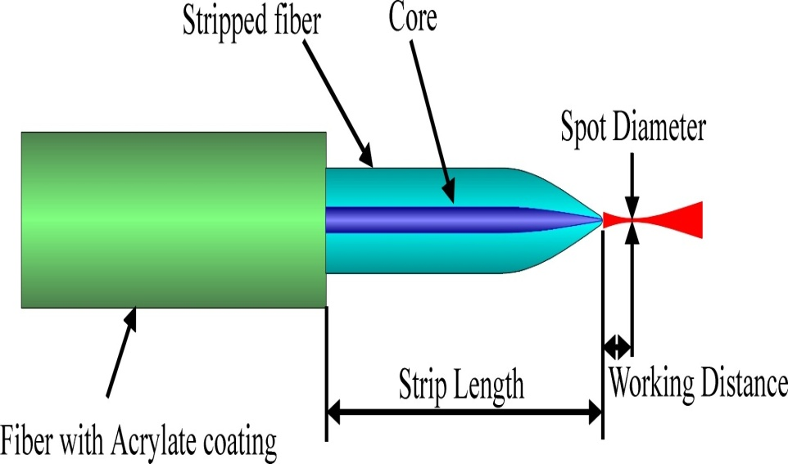
Project Introduction
Tapered Lensed Fiber
Parameters |  | Specifications(Single-mode)
Spot size | Minimum | 1.7µm(λ=1.5µm)
 |  | 0.6µm(λ=0.5µm)
 | Maximum | 6.0µm(λ=1.5µm)
Spot size Tolerence | Without near-field characterization | ±0.5µm
 | With near-field characterization | ±0.25µm
Working Distance | Minimum | 5µm (λ=1.5µm)
 | Maximum | 50µm (λ=1.5µm)
Source:http://www.nanonics.co.il/lensed-fibers.html
Notes:
In last page we have shown the schema of coupling from TLF to waveguide.
The given TLF in the experimental setup is produced by NANONICS. It is fabricted by pulling and melting the regular fiber.
The top figure is the photography of the TLF. The figer right down is the schematic TLF.
The Table gives the technical detail of the TLF in experimental setup.

Slide 6
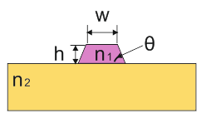
Project Introduction
Waveguide
Working wavelength :λ=1064nm
Waveguide: LiNbO3 with n1=2.516,
w≈1µm, h ≈ 0.5µm
Substrate: SiO2 with n2=1.544
Notes:
The waveguide in this experimental setup is a rib waveguide. The cross-section of the waveguide is a taper. The taper angle is very close to 90 grad. Therefore, the waveguide can approximate a rectangle.

Slide 7
Overview
Motivation and Objective
Project Introduction
Modelling
Optimization
Conclusion and Outlook

Slide 8
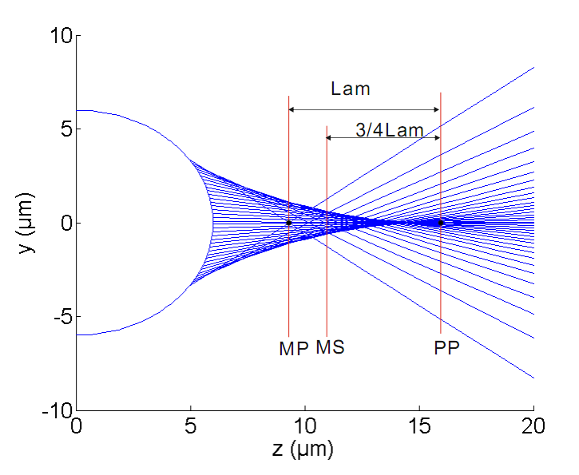
Modelling
Modelling TLF
Working distance
Notes:
In this work only the end part of the TLF is modelled. First step is to determin the lens. It is also assumed the lens end is a hemisphere. Then the refractive index

Slide 9
Modelling

Slide 11
Übersicht
Motivation und Zielsetzung
Einleitung CUDA
Sparse Matrix
IDR(s) Integration
Zusammenfassung und Ausblick

Slide 12
Zeitverhalten
Im Bereich N < 5000 im Sekundenbereich (0s bis 2s) (langsamer als Matlab)
Im Bereich 5000 < N < 1500000 läuft IDR(s)_cuda, aber ohne hinreichende precision (double) momentan nicht sinnvoll meßbar.

Slide 13
Herausforderung Testbarkeit
Host
CPU
CudaMemCopy()
RAM
PCI-Bus
Device
Core
Core
GPU
Core
Core
Device Memory

Slide 14
Kontrollfluss im Selbstest-Modus
for (1...s)
op; op->selbsttest();
op; op->selbsttest();
end;
while( norm(r) ＜ tolr )
for (1...s)
op; op->selbsttest();
Löse(s,s);
op; op->selbsttest();
x = x + delta;
r = rest(A,x,b);
end
op; op->selbsttest();
end;

Slide 15
Struktur für die Testbarkeit
Codeteil | Designpattern
IDR(s) | „Template“
Operationen | „Command“

Slide 16
Testbarkeit im IDR(s)-Durchlauf
dotmul_Kernel
Matmul_Kernel
dotmul_cu
matmul_CPU
selbsttest()
selbsttest()
operation()
operation()
IDR(s)-Kontrollfluß

Slide 17
Übersicht
Motivation und Zielsetzung
Einleitung CUDA
Sparse Matrix
IDR(s) Integration
Zusammenfassung und Ausblick

Slide 18
Zusammenfassung und Ausblick
Bislang in float gemessen,
double Fehler wurde heute mittag gefunden.
Performanceverbesserungen
durch adaptive Kernelwahl möglich,
aber noch nicht eingebaut.
Problemgrößen für N < 2.000.000 handhabbar.

Slide 19
Vielen Dank
für Ihre Aufmerksamkeit

Slide 20
Matrizenmultiplikation
b
C
A
a1
a2
a3
a4
a5
a6
a7
a8
BLOCK 1
c1
BLOCK
BLOCK n
BLOCK 3
BLOCK 2
a3
b
c2
b
b
a2
b
a1
an
c3
c4
c5
c6
c7
c8

Slide 21
Dreieckförmige Summation
0 | 1 | 2 | 3 | 4 | 5 | 6 | 7
Iterationsschritte
0 | 1 | 2 | 3 | 4 | 5 | 6 | 7
0 | 1 | 2 | 3 | 4 | 5 | 6 | 7

Slide 22
Dreiecksummation
#define BLOCK_EXP 9
#define DEF_BLOCKSIZE 1 << BLOCK_EXP
short offset = 1;
for ( short i = 1; i < BLOCK_EXP ; i++ ) {
short old = offset;
offset <<= 1;
if ( threadIdx.x % offset == 0 ) {
Vs[threadIdx.x] += Vs[ threadIdx.x + old ];
}
__syncthreads();
}
if ( threadIdx.x == 0 ) {
out[0] = Vs[0] + Vs[offset];
}

Slide 23
Dreiecksummation
Erwartetes Ergebnis, bei einer Reduktion von 512 Iterationen auf 8 Iterationen Erwartung: Beschleunigung um ca. Faktor 50 ...
Gemessenes Ergebnis: Beschleunigung „ nur“ um Faktor 5 (in Bezug auf rein iterative Summierung auf der GPU)

Slide 24
Literatur
NVIDIA CUDA BestPracticesGuide 2.3
NVIDIA CUDA PrommingGuide 2.3
CudaReferenceManual.pdf
White Paper “Accelerateing MATLAB with CUDA Using MEX Files”
Gaußsches Eliminationsverfahren
http://de.wikipedia.org/wiki/Gau%C3%9Fsches_Eliminationsverfahren
Peter sonneveld, Martin B. Van Gijzen, “IDR(s):A Family of simple and fast algorithms for solving large nosysmmetric systems of linear equations”
Robert Sedgewick,” Algorithmen in C .”, Pearson Studium , ISBN-10: 3827371821
Donald E. Knuth, The Art of Computer Programming 1-3, Addison-Wesley Longman, ISBN-10: 0201485417
David A. Patterson, John L. Hennessy, Computer Organization & Design: The Hardware/Sofware Interface; Morgan Kaufmann; ISBN-10: 155860491X
Brian W. Kernighan, Dennis Ritchie; The C Programming Language; Prentice Hall International; ISBN-10:0131103628

